Slide 1

A Comprehensive study of leaf disease identification on Tomato and Potato Plants.
SRM INSTITUTE OF SCIENCE AND TECHNOLOGY
SCHOOL OF COMPUTING
DEPARTMENT OF COMPUTING TECHNOLOGIES
18CSP107L / 18CSP108L - MINOR PROJECT / INTERNSHIP
Batch ID: 315
Student 1 Reg. No: RA2011003010525
Student 1 Name: Aksh Kalyani
Student 2 Reg. No: RA2011003010536
Student 2 Name: Nipun Chaurasia
Guide name: Dr. S. Priya
Designation: Assistant Professor Department: CTECH

Slide 2
Abstract
India experiences 35% annual crop yield loss due to plant diseases.
Early detection of diseases is challenging due to limited lab infrastructure and expertise. It requires huge time as well as skilled labour.
Exploration of computer vision and machine learning techniques for scalable and early disease detection.
A smart and efficient technique for detection of crop disease is proposed, which uses computer vision and machine learning techniques to detect diseases on 3 major plants.

Slide 3
Introduction
In India about 70% of the populace relies on agriculture. Identification of the plant diseases is important in order to prevent the losses within the yield.
It's terribly troublesome to observe the plant diseases manually.
It needs tremendous quantity of labor, expertize within the plant diseases, and conjointly need the excessive time interval.
Hence, image processing and machine learning models can be employed for the detection of plant diseases

Slide 4
Motivation
In the diverse and vibrant landscapes of India, agriculture has been the backbone of the nation's economy for centuries.
However, the persistent threat of plant diseases continues to challenge the livelihoods of millions of farmers across the country.
It is in this context that our project, focused on Plant Disease Identiﬁcation using Machine Learning (ML) and Deep Learning, takes center stage.

Slide 5
LITERATURE SURVEY
S.No. | Details of Author, Year | Techniques /Title of Paper | Contribution | Merits | Demerits
1. | Pranesh Kulkarni, et Al | Plant Disease Detection Using Image Processing and Machine Learning | The proposed system is able to detect 20 different diseases of 5 common plants with 93% accuracy. | 25 classes for experimentation shape, texture and color features are extracted from the image average 93% accuracy and 0.93 F1 score | Random forest classifier has been used for classification or detection task prone to overfitting problems. computationally efficient
2. | Davinder Singh, et Al | PlantDoc: A Dataset for Visual Plant Disease Detection | Propose an entirely new dataset for plant disease detection called PlantDoc. | MobileNet gives an mAP of 22 when evaluated on COCO dataset which has significantly more classes | there are some images in the dataset which can potentially be wrongly classified
3. | WASSWA SHAFIK, et Al | A Systematic Literature Review on Plant Disease Detection: Motivations, Classification Techniques, Datasets, Challenges, and Future Trends | The study shows a complete data collection and preprocessing strategy for PDD used in academia and business | There are a limited number of publicly accessible datasets on this topic. the bulk of DL models is created using data collected under laboratory circumstances, which may hinder their performance in real-time utilization | - Most studies centered extensively around CNN-based disease detection systems for numerous crops, notably citrus, have been studied
4. | Muhammad E. H. et Al | Automatic and Reliable Leaf Disease Detection Using Deep Learning Techniques | Different variants of U-net architecture are investigated to propose the best segmentation model by comparing the model predictions to the ground truth segmented images. | The obtained results show that our model outperforms some recent deep learning techniques by using the most popular publicly available Plant Village dataset
5. | Monika Lamba et Al | Classification of plant diseases using machine and deep learning | This paper proposed a model comprising of Auto-Color Correlogram as image filter and DL as classifiers with different activation functions for plant disease | -obtaining 99.4% accuracy and 99.9% sensitivity for binary class and 99.2% accuracy for multiclass. It is proven that the proposed model outperforms other approaches, namely LibSVM, SMO and DL. - | -It is required to represent mediator representations of the data that other machine learning methods cannot easily do. -

Slide 6
LITERATURE SURVEY
S.No. | Details of Author, Year | Techniques /Title of Paper | Contribution | Merits | Demerits
6. | Sharada P. Mohanty, et Al | Using Deep Learning for Image-Based Plant Disease Detection | Using a public dataset of 54,306 images of diseased and healthy plant leaves collected under controlled conditions, we train a deep convolutional neural network to identify 14 crop species and 26 diseases | the model correctly classifies crop and disease from 38 possible classes in 993 out of 1000 images | when tested on a set of images taken under conditions different from the images used for training, the model’s accuracy is reduced substantially, to just above 31%
7. | Muhammad Shoaib, et Al | An advanced deep learning models-based plant disease detection: A review of recent research | This paper provides an overview of the current developments in the field of plant disease detection using ML and DL techniques. By covering research published between 2015 and 2022, it provides a comprehensive understanding of the state-of-the-art techniques and methodologies used in this field. | Accessible datasets for training and evaluation Development of generalizable models Improved plant disease detection | The study’s scope is confined to publications from 2015 to 2022, implying that recent developments in plant disease detection may not be covered.
8. | M.Shobana, et Al | Plant Disease Detection Using Convolution Neural Network | This paper contribution lies in the successful implementation of CNNs for plant disease detection and its focus on simplicity, practicality, and accessibility. | focus on using CNNs for plant disease detection | - lack of more detailed information about the datasets used - specific CNN architecture details

Slide 7
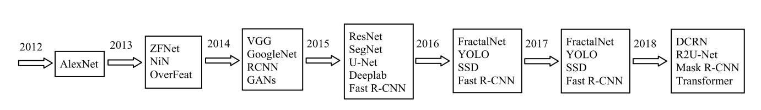
Existing System

Slide 8
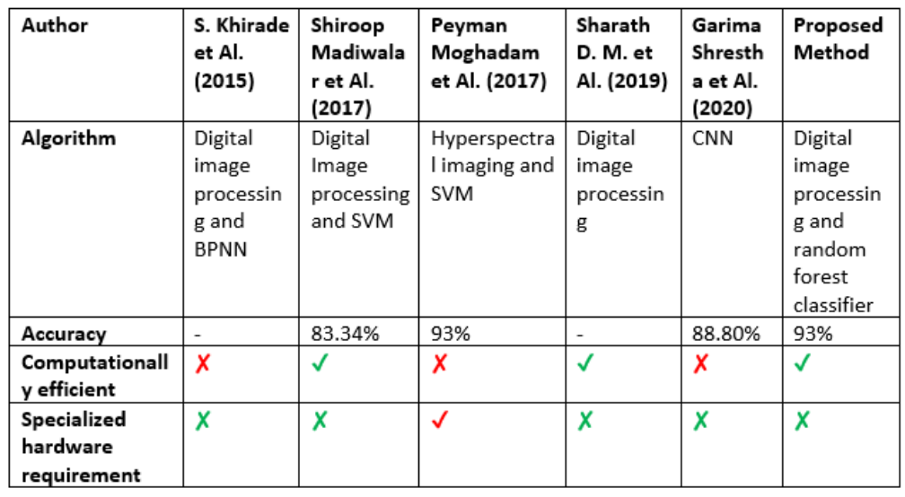
Comparison Analysis

Slide 9
Objective
The primary objective of our leaf disease identiﬁcation is to develop a robust and efﬁcient-AI-powered system that improves the detection and management of leaf diseases.

Slide 10
Scope
Data Collection and Annotation
Disease Detection
Model Training and Validation

Slide 11
Proposed System
The analysis of the methodology of the proposed work has been presented using images.
Image datasets are collected from the potato and tomato dataset and the Kaggle plant village dataset.
These images go through pre-processing called filtering. After the pre-processing step, different texture and color features are collected.
The features obtained are fed as an input in DL to correctly classify the disease of a given plant.

Slide 12
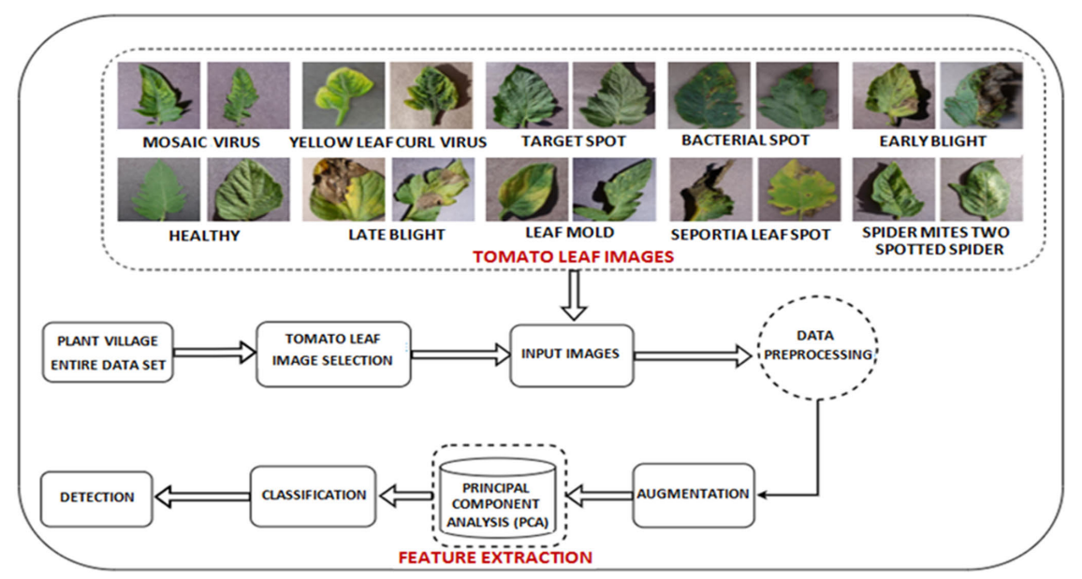
Architecture Diagram

Slide 13
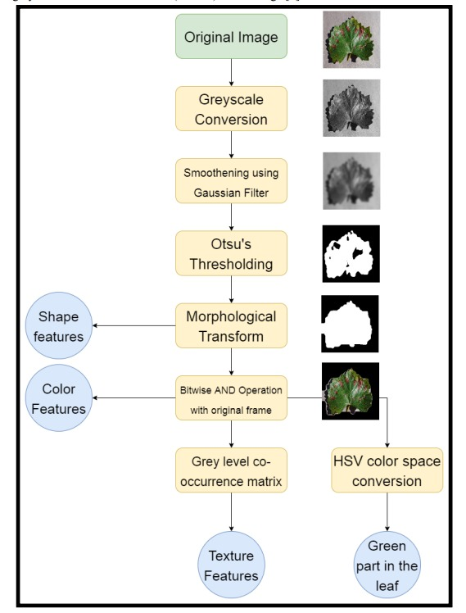
Data Preprocessing

Slide 14
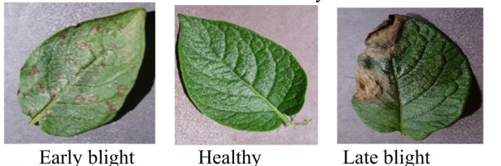
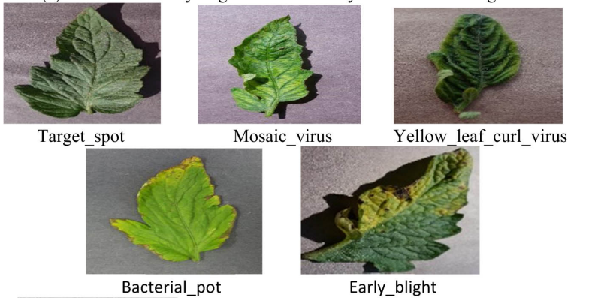
Proposed System
Potato Leaves:
Tomato Leaves:

Slide 15
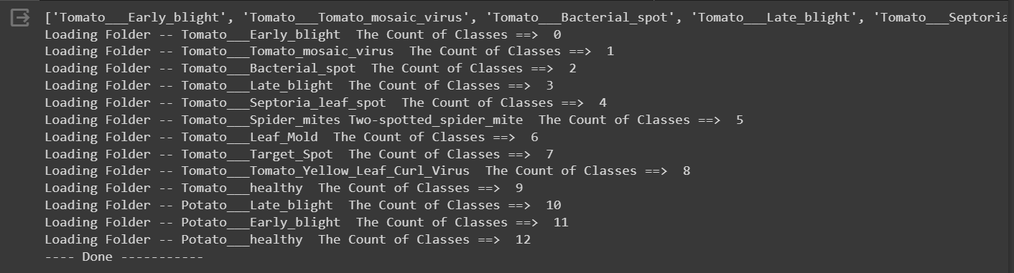
Output
1. Reading Image Data

Slide 16
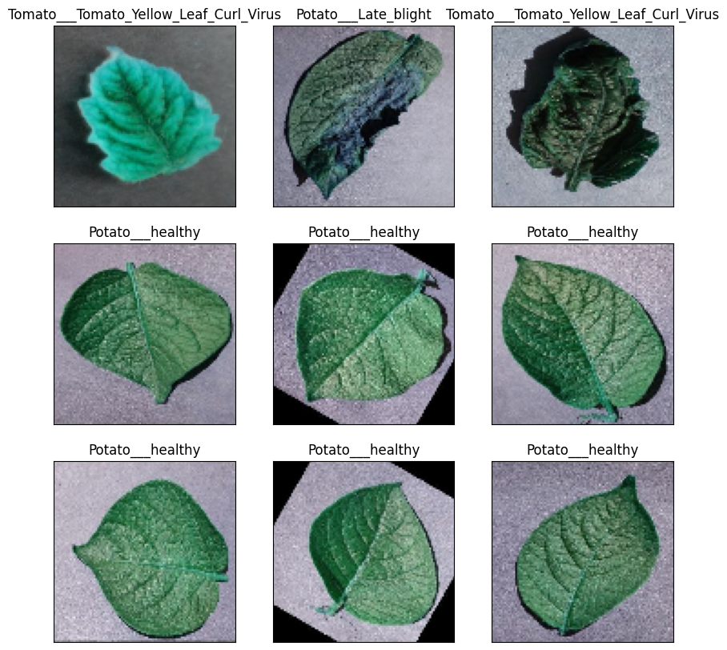
Output
2. Data Visualisation
Data Visualization

Slide 17
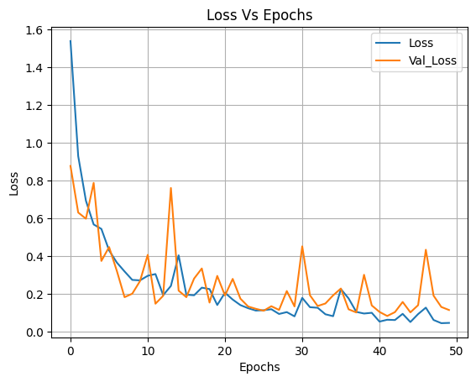
Output
3. Epochs

Slide 18
References
WASSWA SHAFIK , (Member, IEEE), ALI TUFAIL , (Senior Member, IEEE), ABDALLAH NAMOUN , (Member, IEEE), LIYANAGE CHANDRATILAK DE SILVA , (Senior Member, IEEE), AND ROSYZIE ANNA AWG HAJI MOHD APONG “A Systematic Literature Review on Plant Disease Detection: Motivations, Classification Techniques, Datasets, Challenges, and Future Trends “
Muhammad E. H. Chowdhury, Tawsifur Rahman, Amith Khandakar, Mohamed Arselene Ayari, Aftab Ullah Khan, Muhammad Salman Khan, Nasser Al-Emadi, Mamun Bin Ibne Reaz, Mohammad Tariqul Islam and Sawal Hamid Md Ali “Automatic and Reliable Leaf Disease Detection Using Deep Learning Techniques “
Muhammad Shoaib, Babar Shah, Shaker EI-Sappagh, Akhtar Ali, Asad Ullah, Fayadh Alenezi, Tsanko Gechev, Tariq Hussain, and Farman Ali “An advanced deep learning models-based plant disease detection: A review of recent research ”
Pranesh Kulkarni , Atharva Karwande , Tejas Kolhe , Soham Kamble , Akshay Joshi , Medha Wyawahare “Plant Disease Detection Using Image Processing and Machine Learning”
Monika Lamba Yogita Gigras Anuradha Dhull “Classification of plant diseases using machine and deep learning”
STEFANIA BARBURICEANU , SERBAN MEZA , (Member, IEEE), BOGDAN ORZA , RAUL MALUTAN, AND ROMULUS TEREBES, (Member, IEEE) “Convolutional Neural Networks for Texture Feature Extraction. Applications to Leaf Disease Classification in Precision Agriculture ”

Slide 19
References
VIBHOR KUMAR VISHNOI , (Member, IEEE), KRISHAN KUMAR , BRAJESH KUMAR , (Senior Member, IEEE), SHASHANK MOHAN , AND ARFAT AHMAD KHAN “Detection of Apple Plant Diseases Using Leaf Images Through Convolutional Neural Network”
KYAMELIA ROY , SHELI SINHA CHAUDHURI , (Member, IEEE), JAROSLAV FRNDA , (Senior Member, IEEE), SRIJITA BANDOPADHYAY , ISHAN JYOTI RAY , SOUMEN BANERJEE , (Senior Member, IEEE), AND JAN NEDOMA , (Senior Member, IEEE) “Detection of Tomato Leaf Diseases for Agro-Based Industries Using Novel PCA DeepNet”
SABBIR AHMED , MD. BAKHTIAR HASAN , TASNIM AHMED, MD. REDWAN KARIM SONY, AND MD. HASANUL KABIR , (Member, IEEE) “Less Is More: Lighter and Faster Deep Neural Architecture for Tomato Leaf Disease Classification”
K. P. ASHA RANI AND S. GOWRISHANKAR “Pathogen-Based Classification of Plant Diseases: A Deep Transfer Learning Approach for Intelligent Support Systems”
LILI LI , SHUJUAN ZHANG , AND BIN WANG “Plant Disease Detection and Classification by Deep Learning—A Review”
Davinder Singh, Naman Jain, Pranjali Jain, Pratik Kayal Sudhakar Kumawat, Nipun Batra “PlantDoc: A Dataset for Visual Plant Disease Detection”
M. Ishaq , M. Waqas “Early Detection of Late Blight Tomato Disease using Histogram Oriented Gradient based Support Vector Machine ”
Sharada P. Mohanty , David P. Hughes and Marcel Salathé “Using Deep Learning for Image-Based Plant Disease Detection”

Slide 20
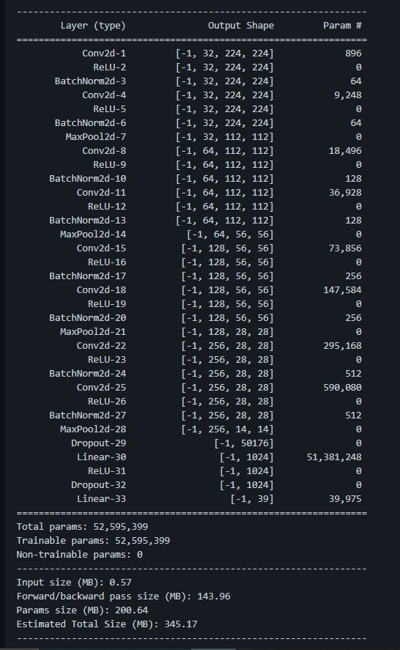
Architecture of Model

